Slide 1
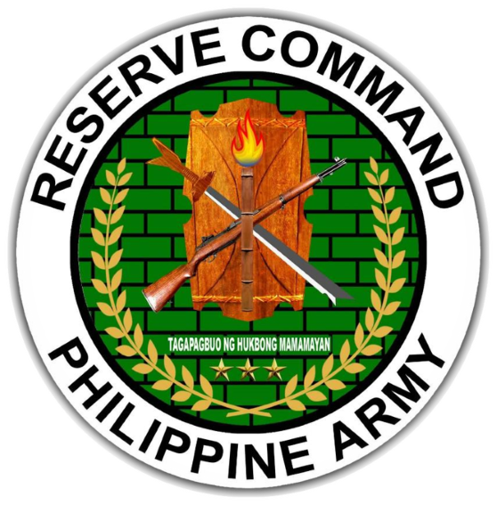
WELCOME
CADETS

Slide 2
SSG JOSEPH NIALL G ARAGON PA (RES)
UNIT DESIGNATION: BATTALION OPNS NCO
UNIT ASSIGNMENT: 504RRIBn, 1701RRIBde, PA
MOBILIZATION UNIT: 504CDC, 5RCDG, RESCOM, PA
SENIOR INSTRUCTOR FOR ARMY BASIC INSTRUCTOR COURSE (ABIC) & COMBAT LIFESAVER COURSE (CLCS) – AFP-GUNG SPP
INSTRUCTOR FOR OFFICER PROFESSIONAL DEVELOPMNENT COURSE (OPDC) – AFP-GUNG SPP
TECHNICAL INSTRUCTOR FOR HA/DR
LEVEL III CHAMELEON – CMOCEC CLASS 2 2017

Slide 3
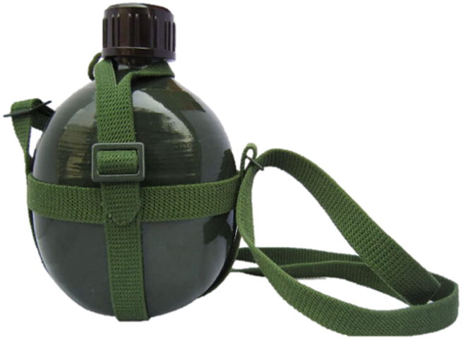
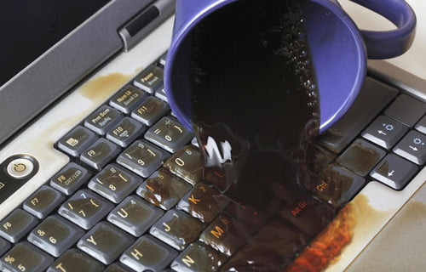
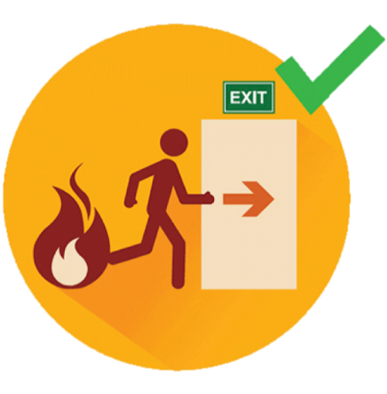

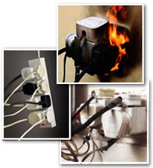


Slide 4

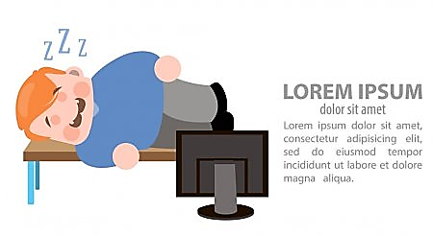
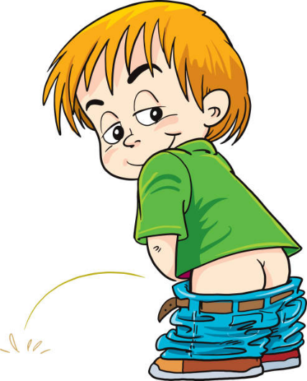
CLASSROOM RULES
Be responsible to keep yourself awake
Finds your way towards the toilet silently when you feel the urge
If there is any question, just write it down on the comment box for those who are online, for the F2F keep your question to yourself and wait to be acknowledged

Slide 5
REFERENCES
FC 1-012 AFP CODE OF ETHICS; FC 8-039 Army NCO Guide

Slide 6
MILITARY CUSTOMS AND TRADITIONS

Slide 7
TERMINAL LEARNING OBJECTIVE
ACTION:
Discuss and Identify the Military Customs and Tradition
CONDITION:
Given in an online and face to face classroom environment, power-point presentation
STANDARD:
The student will:
understand the definition of customs and traditions
military traditions
significance of military customs

Slide 8
SCOPE OF LEARNING
Definitions of Customs and Traditions
Military Traditions
Significant Military Customs
Army Customs and their Importance
Rank Has Its Privileges (RHIP)
The Newcomer Shall be Well Received
Customs in Connection with Sickness and Death
Support of Post and Organization Activities
Taboos
The Army's Bugle Calls
Military Traditions

Slide 9
DEFINITION OF TERMS
Traditions - are inherited principles, standards and practices that serve as the established guides for an individual or group
Customs - are accepted practices realized through continued usage that has force and effect of a common law

Slide 10

MILITARY TRADITION
VALOR - AN ACT OF A MARKED DEGREE OF COURAGE AND BRAVERY IN THE PRESENCE OF DANGER OR IN THE FACE OF THE ENEMY
DUTY - AN ACT OF RESPONSIBILITY AND SELF-SACRIFICE A SOLDIER WHO HAS DEDICATED HIS LIFE TO PUBLIC SERVICE.

Slide 11
MILITARY TRADITION
HONOR - AN ACT OF RESPECT GAINED BY MEN AND WOMEN OF THE AFP FROM THE CIVILIAN POPULACE THROUGH GOOD DEEDS AND GOOD EXAMPLES
SOLIDARITY - AN ACT OF UNITY AND TEAMWORK SHOWN BY EVERY MEMBER OF THE AFP WHICH SERVES AS AN ALLY IN THE ACCOMPLISHMENT OF THE MISSION.

Slide 12
MILITARY TRADITION
LOYALTY - AN ACT OF WILLING OBEDIENCE TO THE GOVERNING LAWS OF THE COUNTRY, THE CONSTITUTION, AND LAWFUL SUPERIORS

Slide 13
MILITARY CUSTOMS
NATIONAL COLORS AND ANTHEMS
- THE PHILIPPINE FLAG AND THE NATIONAL ANTHEM SYMBOLIZE ALL DEMOCRATIC IDEALS THAT OUR COUNTRY STAND FOR AND SERVE TO REMIND US OF THE SACRIFICES OF OUR HEROES IN GAINING OUR INDEPENDENCE FROM FOREIGN RULE.

Slide 14
MILITARY CUSTOMS
NATIONAL COLORS AND ANTHEMS
National Flag – we should always respect the National Flag by saluting it whenever it passes during parades and other ceremonies where it is raised or lowered

Slide 15
MILITARY CUSTOMS
NATIONAL FLAG
a) When aboard a vehicle and a flag ceremony begins, halt, dismount and face the Philippine flag and salute. It is impractical to dismount or when ceremony is almost over, you may just halt and sit erect.
b) When the Philippine Flag is tattered or worn down, do not display it anymore. Replace them immediately. Note: The best way to dispose a tattered flag is to bury it.

Slide 16
MILITARY CUSTOMS
NATIONAL COLORS AND ANTHEMS
National Anthem – the same measure of respect and reverence is shown to the National Anthem.
a) When it is being played, face the source of the music (amplifier) or the band playing it and salute.
b) When with a group, not in formation, you may salute individually during the play of the National Anthem.

Slide 17
MILITARY CUSTOMS
MILITARY SENIORITY
Ranks has its privilege – by military traditions, officers and senior NCOs enjoy some RHIPs

Slide 18
MILITARY CUSTOMS
RANKS HAS ITS OWN PRIVILEGE
Pointers to remember when addressing or dealing with an Officer:
a) Salute – render salute in a dignified manner.
b) Word of Address – always use the word “Sir”, “Po” or “Opo”.
c) Position of Honor – when walking, sitting or riding a vehicle with a officer or any senior, always walk or sit on his left side.
d) Commander’s wish – when a commander says “I desire. . . .” or “I wish”, this expression should be taken and carried out with all authority and force of direct order.

Slide 19
MILITARY CUSTOMS
MILITARY SENIORITY
NCOs Ranks and Positions – NCOs attain their ranks and position by virtue of their competence and qualifications. Thus, to be promoted and be designated as head NCOs or Chief of a unit is always considered as an achievement.

Slide 20
MILITARY CUSTOMS
NCOs RANKS AND POSITIONS
Points to remember when addressing and dealing with a senior CO.
a) In the Philippine Army and Philippine Air Force, Technical Sergeants are addressed as “Tech”, Chief, Senior or Master Sergeant as “Master”. If uncertain with the rank, politely address them as “Sarge”.

Slide 21
MILITARY CUSTOMS
NCOs RANKS AND POSITIONS
Points to remember when addressing and dealing with a senior CO.
b) Private First Class and Privates may normally be addressed as “Private”; to some, it is more flattering to be called “Warrior”, “Trooper” for members of the Special Forces, “Ranger” for Scout Rangers, “Noy” or “Iho” may be addressed by an officer to junior enlisted personnel.

Slide 22
MILITARY CUSTOMS
NCOs RANKS AND POSITIONS
Points to remember when addressing and dealing with a senior CO.
c) First names may be addressed to juniors or contemporaries only and never to seniors.

Slide 23
MILITARY CUSTOMS
NCOs RANKS AND POSITIONS
Points to remember when addressing and dealing with a senior CO.
d) Generally accepted way of making up informal military nicknames is to used the first two syllables of the soldier’s name such as “Tintoy” or “Toinks” for Tolentino.

Slide 24
MILITARY CUSTOMS
FUNERALS AND RELIGIOUS SERVICES
1) Taps – “funeral bugle call”. During this solemn ceremony, all military personnel present come to attention and salute. After the shots, the “taps” is sounded. The National Flag draped over the casket is slowly removed and neatly folded by the most senior officer or NCO and given to immediate family member of the deceased.

Slide 25
MILITARY CUSTOMS
FUNERALS AND RELIGIOUS SERVICES
2) Funeral Visitation – the Commanding Officer sends his personal letter of condolences to the bereaved family of his men. Military vigil guards shall be posted beside the casket and a standardized Philippine Flag shall be draped over it.

Slide 26
MILITARY CUSTOMS
MILITARY WEDDINGS
1) Background Investigation (BI) – Officers and Enlisted personnel are required by AFP regulations to request permission to marry from their commanding officer by submitting a properly accomplished Personal Action Form (PAF) and by requesting for a Background Investigation on his prospective bride. The BI is not intended to find out if a soldier had made the right personal choice, but rather to determine if his future wife will not be potential risk for the AFP.

Slide 27
MILITARY CUSTOMS
MILITARY WEDDINGS
2) “Draw Swords” Ceremony – a traditional military church wedding. The bride and the groom (an officer of NCO) may wish to have this ceremony. A Military Sword Detail of at least four pairs of officers or NCOs shall be organized among the friends of the groom in his unit.

Slide 28
MILITARY CUSTOMS
VISITATIONS
1) Hospital Visits
2) Field Visits

Slide 29
MILITARY CUSTOMS
MILITARY CEREMONIES AND SOCIALS
1) Parades – Military parades and review are held in military camps to honor senior commanders, government officials and dignitaries. Parade and Reviews may be held both in the morning or in the afternoon and mainly to showcase to the Guest of Honor and audience the smart appearance and executions of the troops.

Slide 30
MILITARY CUSTOMS
MILITARY CEREMONIES AND SOCIALS
2) Military Honors
a) Full Complement Honors
(1) Dignitaries Gun Salute Ruffles Music Unit Size
Arr l/ Optr
President/Ex-President 21 21 4 Nat’l Anthem Bn
Foreign Heads of State 21 21 4 Nat’l Anthem Bn
Vice President 19 19 4 March Bn
Chief of Justice 19 19 4 March Bn
Department Secretaries 19 19 4 March Bn

Slide 31
MILITARY CUSTOMS
MILITARY CEREMONIES AND SOCIALS
2) Military Honors
a. Full Complement Honors
(2)Military Officers Gun Salute Ruffles Music Unit Size
Arr l/ Optr
Chief of Staff 19 19 4 Gen March Bn
General 17 17 4 Gen March Bn
Lieutenant General 15 15 4 Gen March Bn
Major General 13 2 Gen March Coy
Brigadier General 11 1 Gen March Coy

Slide 32
MILITARY CUSTOMS
MILITARY CEREMONIES AND SOCIALS
2) Military Honors
a. Sideboys and Plane Side Honors
(1)Civilian Dignitaries Sideboys Plane Side Honors
Officer EP Officers EP
President/Ex-President 1 8 1 20
Foreign Heads of State 1 8 1 20
Vice President 1 8 1 18
Senator / Congressmen 1 8 1 16
Chief of Justice 1 8 1 16
Department Secretaries 1 8 1 16

Slide 33
MILITARY CUSTOMS
MILITARY CEREMONIES AND SOCIALS
2) Military Honors
a. Sideboys and Plane Side Honors
(1)Military Officers Sideboys Plane Side Honors
Officer EP Officers EP
General 1 8 1 16
Lieutenant General 1 8 1 14
Major Service Commanders 1 8 1 14
Military Vicar 1 6 1 12
Major General 1 6 1 12
Brigadier General 1 6 1 10
Colonel/Lt Colonel 1 4 - -
Other Commissioned
Officers 1 2 - -

Slide 34
MILITARY CUSTOMS
MILITARY CEREMONIES AND SOCIALS
3) Unit Anniversaries
4) Happy Hours

Slide 35
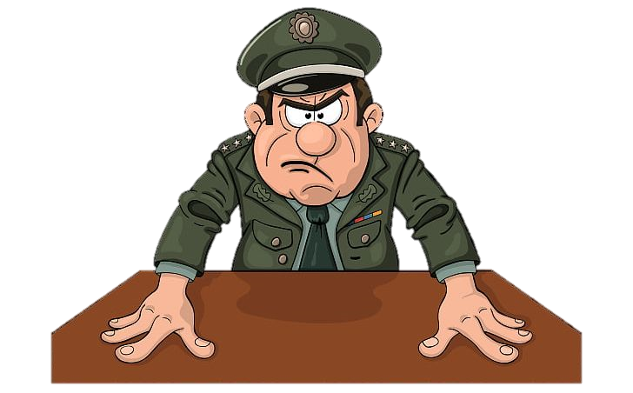
Any Question?

Slide 36
CHECK ON LEARNING

Slide 37
SUMMARY
Definitions of Customs and Traditions
Military Traditions
Significant Military Customs

Slide 38


